Slide 1

Project on Healthcare Analytics
Presented By : Group 6
  Nikhil Rohidas Naik
  Siddhesh Satish Kadam
  Medabala Sujith Kamal Kumar
  Harshada Arvind Chavan
  Rakhee Singha
  Shilpa Rohan Chavan
This project focuses on developing a BI dashboard for Electronic Medical Records (EMR) to provide actionable insights for healthcare providers and administrators.

Slide 2




Project Scope & Analytics Stack
Centralizing fragmented Electronic Medical Records into unified decision-support dashboards.
MS Excel
Schema normalization.
Initial data cleaning.
Core Goal: Empower hospital administrators with KPI visibility.
Clinical Focus: Track patient visits, lab results, and treatments.
Quality Assurance: Cross-verify metrics across four platforms.
Power BI
DAX modeling.
Visual exploration.

Slide 3
Understand the Data
Perform Data cleaning
Data modeling
Project Steps for Healthcare Data Analytics
Perform necessary Calculations
KPI creation
Add Visualization
Add Interactivity
Dashboard design
Business insights for final Conclusions.

Slide 4
Relational Tables (DataSets)
Patient Table
Doctor Table
Visit Fact Table
Lab result Table
Treatments Table
Demographics via Patient ID.
Specialties via Doctor ID.
Central hub linking records.
Diagnostic outcomes per visit.
Medications prescribed per visit.

Slide 5

Clean and prepare the data
Remove
Remove duplicate records
Handle
Handle NULL values
Correct
Correct data types
Text
Clean text fields
Convert
Convert dates
Validate
Validate numerical values
Create
Create calculated columns

Slide 6
Executive KPI Snapshot
10,000
1,000
10,000
33.54%
Total Patient Visits
Active Doctors
Total Lab Tests
Abnormal Lab Rate
$5.25M
$524.75
48.94
10.0
Total Treatment Cost
Avg Cost Per Treatment
Average Patient Age
Avg Visits Per Doctor

Slide 7

Excel
Excel is excellent when we need to:
Utilize the provided Excel data to create an initial dashboard.
Prepare small/medium-sized reports
We use:
Power Query → PivotTable → PivotChart → Slicer → Dashboard
Advantage
Very easy and familiar.
Disadvantage
For a large and complex BI project, Excel dashboards can become difficult to maintain.
Perform basic data cleaning and transformation.
Identify key metrics (KPIs) and define data visualization requirements.
Create PivotTables
Use formulas
Perform quick analysis

Slide 8
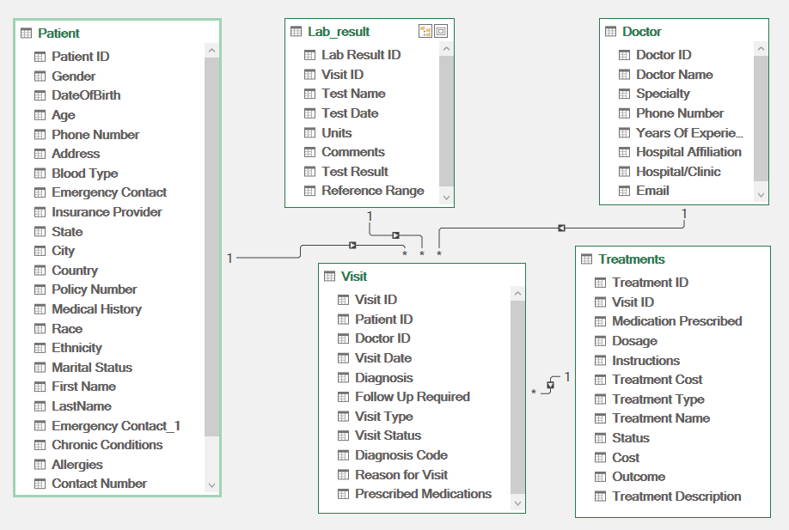
Relational Schema

Slide 9
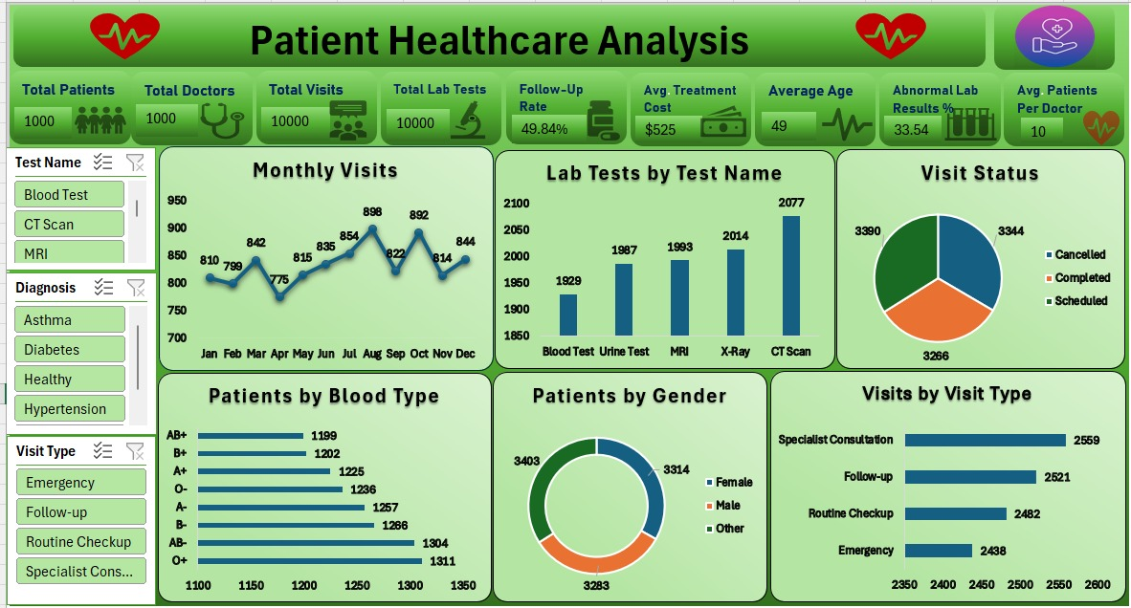
Excel Dashboard

Slide 10
Excel Project: Challenges & Solutions
Challenge Faced in Excel | Solution Implemented
Multi-Sheet Lookup Overhead: Slow VLOOKUPs across 5 relational EMR tables | Migrated to Power Pivot Data Model using 1-to-Many table relationships
Raw Data Inconsistencies: Duplicate records, blank cells, mixed date formats | Automated data cleaning via Power Query before generating Pivot Tables
Slicer Sync Conflicts: Slicers failing to filter all 6 dashboard charts together | Linked all Pivot Charts through Report Connections on a shared data cache
Static KPI Banner Cards: Manual summary formulas not updating with filters | Connected top KPI shapes dynamically to hidden Pivot cells via GETPIVOTDATA
Cross-Tool Number Mismatch: 1,000 Patient subset vs 10,000 full SQL dataset | Verified sample subset ratios against MySQL QA queries for metric accuracy

Slide 11
MySQL-Database & SQL Analysis
MySQL is basically the database and SQL analysis layer, while Excel, Power BI, and Tableau are visualization tools.
HealthCare Analysis
↓
MySQL
↓
Data Cleaning & SQL
↓
Views / Procedures
↓
┌─────────────────────────────┐
↓ ↓ ↓
Excel Power BI Tableau
↓ ↓ ↓
Analysis Dashboard Visualization

Slide 12
What MySQL does in the project
Schema Normalization: Structured five tables to eliminate data redundancy.
Column Standardization: Removed spaces using ALTER TABLE RENAME scripts.
KPI Benchmarking: Computed Follow-Up Rate, Age, and Lab splits.
QA Count Verification: Validated 10K visits and 7,359 treatments.

Slide 13
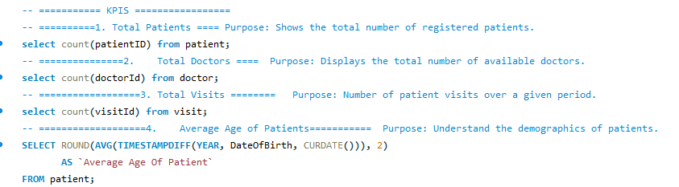
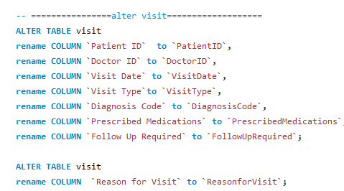
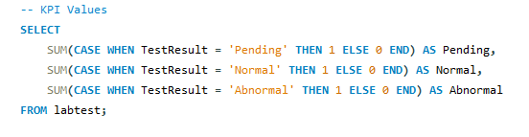
SQL QUERIES
KPI’s
Alter Visit
KPI values

Slide 14
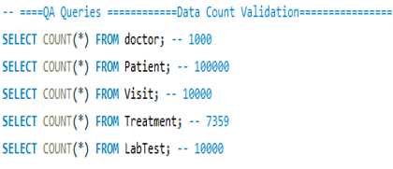
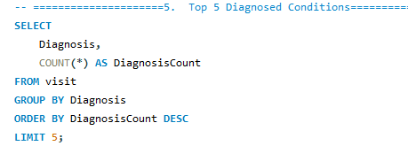
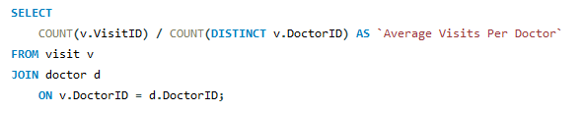
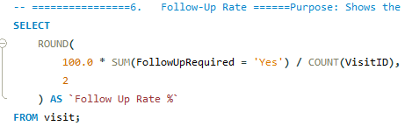
Data Count Validation
Top 5 Diagnosed Conditions
Average Visits per Doctor
Follow Up Rate

Slide 15
MySQL Project: Challenges & Solutions
Challenge Encountered | Solution Implemented
UTF-8 BOM & Unknown Columns | Re-encoded CSVs to UTF-8 and ran ALTER TABLE RENAME.
ONLY_FULL_GROUP_BY SQL Error | Included all non-aggregated columns in GROUP BY clauses.
Incorrect Date & Decimal Values | Converted dates to YYYY-MM-DD and costs to DECIMAL(10,2).
Out-of-Range & Invalid JSON Text | Sanitized clinical text strings before bulk table import.

Slide 16
Power BI-Used For:
Complete Business Intelligence solution.
Power BI is particularly strong in:
Data transformation
Data modeling
Relationships
DAX
KPI calculations
Interactive dashboards
Drill-through
Scheduled refresh
Microsoft ecosystem
Enterprise reporting
Advantage
Best all-round BI tool of the three.
Disadvantage
DAX and data modeling require more learning.

Slide 17
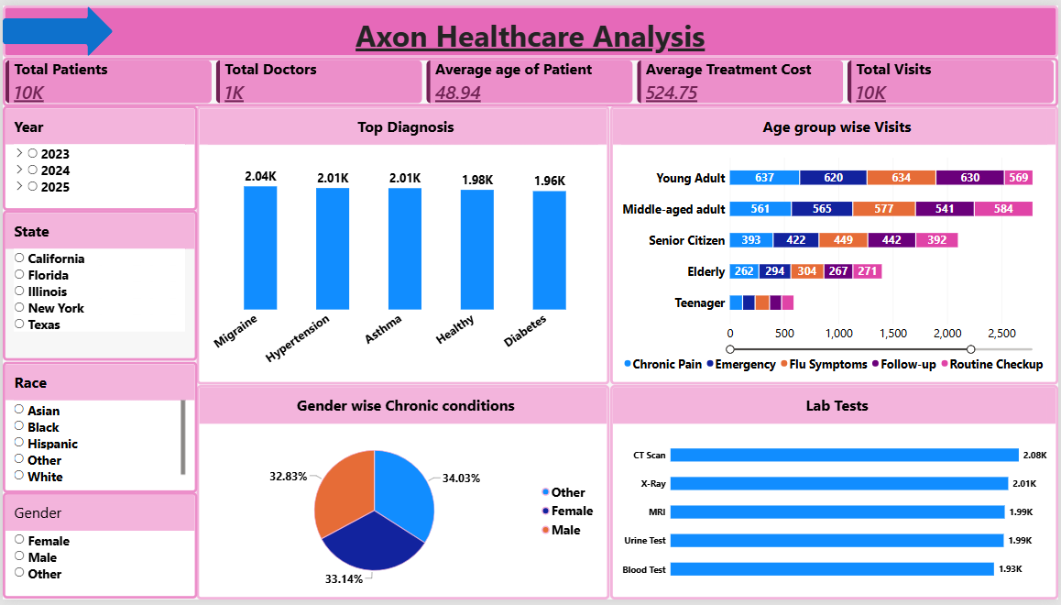
Power BI-Dashboard 1

Slide 18
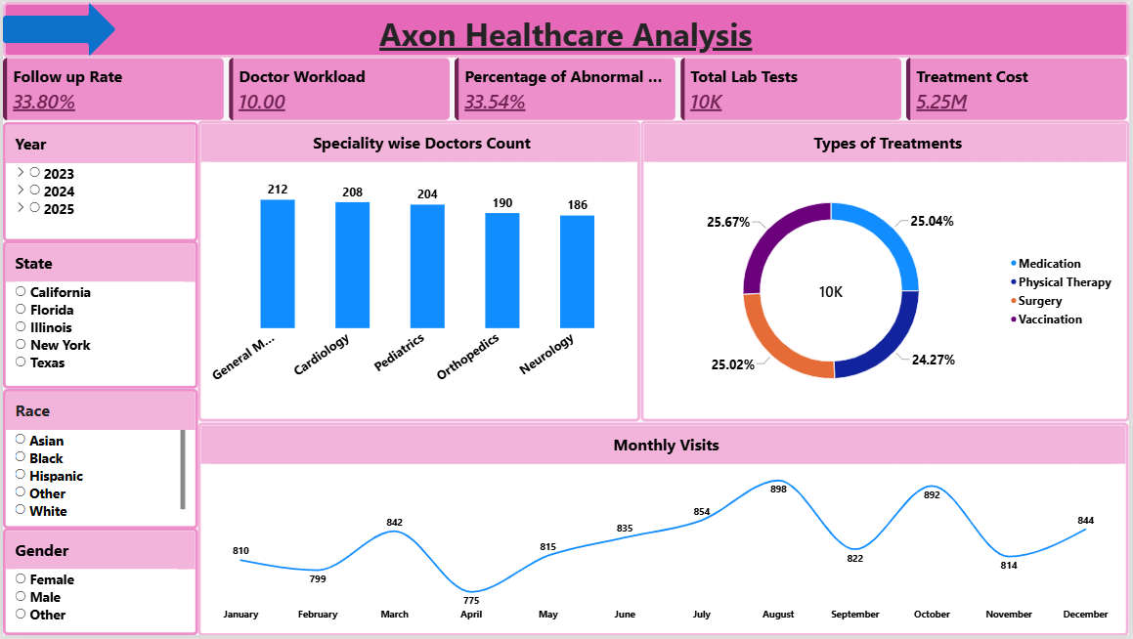
Power BI-Dashboard 2

Slide 19
Power BI Project: Challenges & Solutions
Challenge Encountered | Solution Implemented
Multi-Table Blanks & Duplicates | Cleaned records and standardized types via Power Query.
Ambiguous Table Relationships | Built 1-to-Many Star Schema around Visit table.
Complex DAX & Date Intelligence | Created dedicated Calendar table and optimized DAX measures.
Cross-Tool KPI Reconciliation | Verified Treatment Cost and Abnormal Lab % against MySQL.

Slide 20
Tableau
Tableau is particularly strong in:
Beautiful dashboards
Advanced visualizations
Interactive analysis
Maps
Dashboard actions
Visual exploration
Storytelling
Ensure a user-friendly interface with filters, drill-throughs, and tooltips.
Incorporate advanced analytics, such as trend analysis and forecasting.

Slide 21
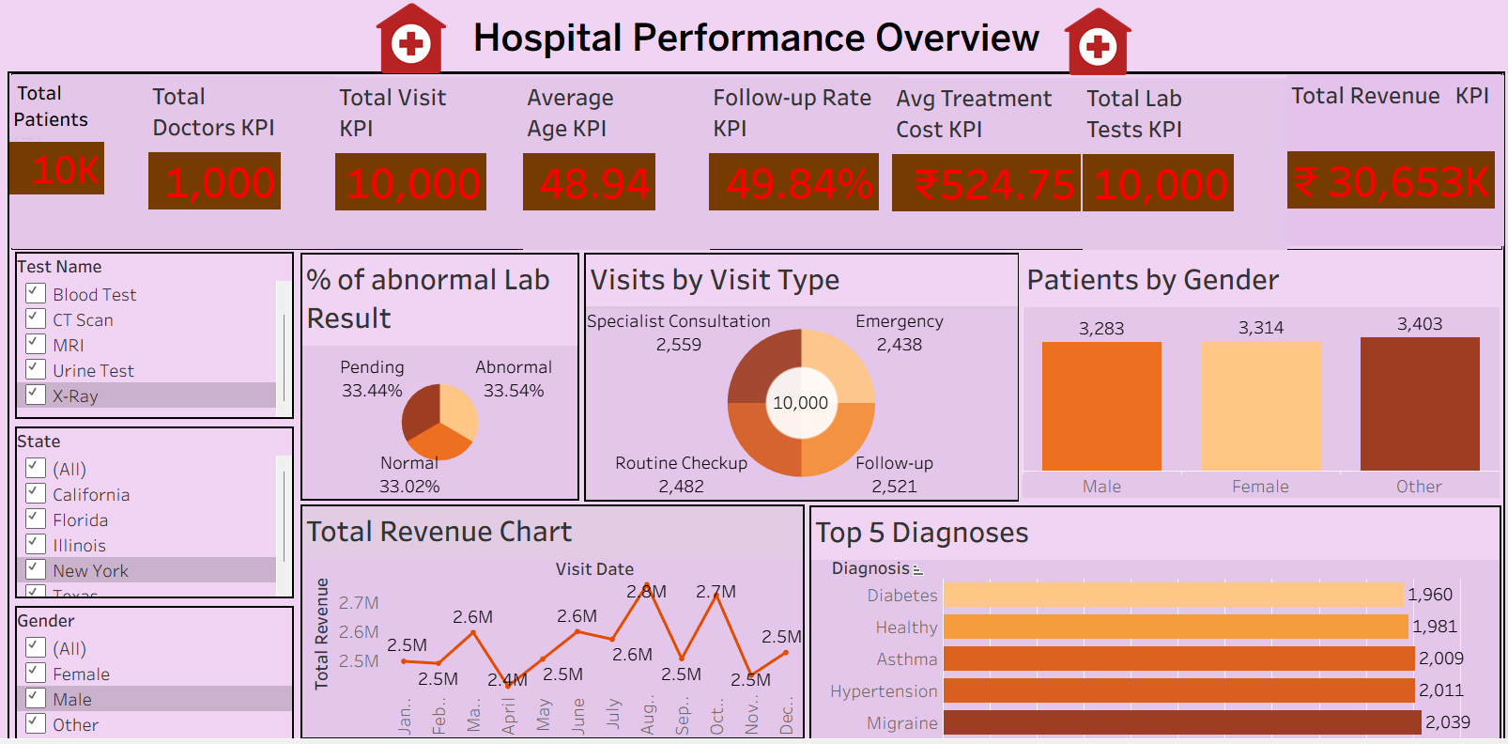
Tableau Dashboard

Slide 22
Tableau Project: Challenges & Solutions
Challenge Faced in Tableau | Solution Implemented
Handling 5 Relational Tables: Physical joins duplicated patient visit records | Used Tableau Logical Relationships (Noodles) to preserve table granularity
Creating Calculated Fields: Complex ratios for Abnormal Lab % & Follow-Up Rate | Authored FIXED Level of Detail (LOD) expressions for accurate aggregations
Date Analysis & Parameters: Switching between Yearly, Quarterly, Monthly views | Built dynamic Date Truncation Parameters for interactive time-series drilldown
Filter & Parameter Interaction: Filters failing to update all worksheets | Configured Context Filters and dashboard-wide "Use as Filter" Actions
Validating Visual Results: Ensuring visual totals matched backend database | Cross-checked Tableau summary cards against MySQL COUNT & AVG queries

Slide 23
Key Business & Clinical Insights
Neurology Staffing Gap: Migraine is #1 diagnosis (2.04K), but Neurology has fewest doctors (186).
33.4%
Seasonal Surge: Patient traffic peaks in August (898) and October (892).
Appointment Cancellation Rate
Working-Age Demand: Young and Middle-Aged adults drive 60% of visits.
3,344 of 10,000 scheduled visits were cancelled.
High Imaging Volume: CT Scans (2,077) and X-Rays (2,014) lead diagnostics.

Slide 24
Recommendations & Future Scope
Automated Reminders
ML No-Show Model
Expand Neurology
Live EMR Pipeline
Recruit neurologists for high migraine load.
Predict appointment cancellations using machine learning.
Automate real-time SQL dashboard refreshes.
Cut 33.4% cancellations via SMS alerts.

Slide 25

Conclusion :
By using all these different tools, we were able to identify the business Insights, important trends, opportunities, problems, and patterns from healthcare data to support better business decisions.
Compare database records with dashboard visuals to ensure data accuracy.
Perform end-to-end testing of calculations and relationships.
Validate against business requirements and make necessary improvements.

Slide 26

Thank You
Group-6 :
  Nikhil Rohidas Naik
  Siddhesh Satish Kadam
  Medabala Sujith Kamal Kumar
  Harshada Arvind Chavan
  Rakhee Singha
  Shilpa Rohan Chavan

